Slide 1
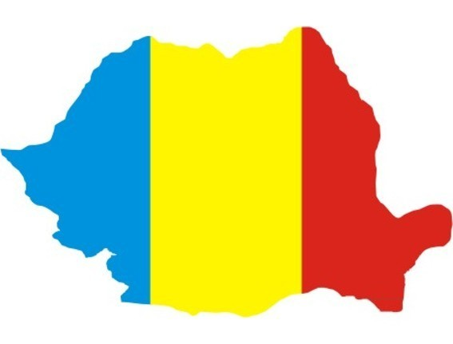
ROMANIA

Slide 2
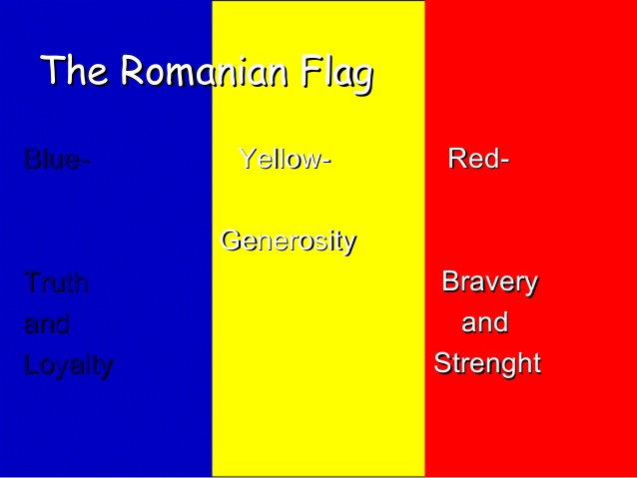

Slide 3
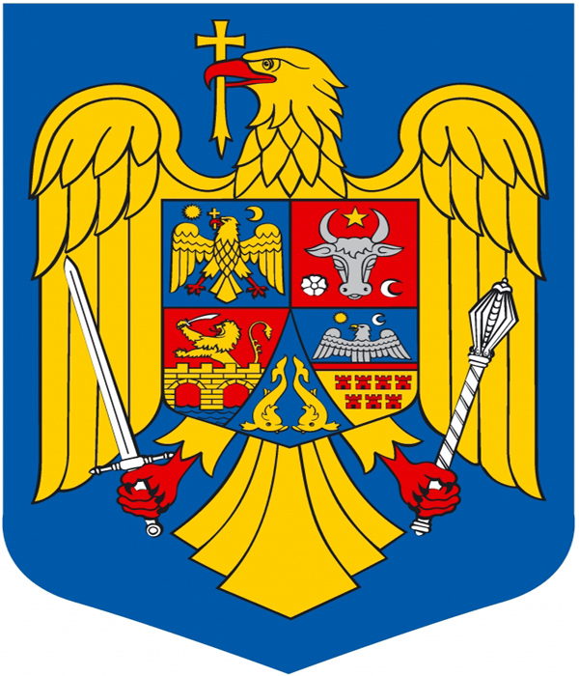
A SYMBOL OF our COUNTRY
Heraldic symbols of the state are part of the national identity.
The current coat of arms was developed after the Revolution of December1989.
The components of the national coat of arms of Romania include:
Golden Eagle- central element symbolizing the founding Basarab dynasty, the nucleus around which was organized Romanian Country, one of the three provinces of the Middle Ages (Walachia, Moldavia and Transylvania)
Shield on which it is azur- symbolizes the sky. The eagle holds in its talons the insignia of sovereignty: a scepter and a sword, which remind of the Romanian ruler Michael the Brave, the first unifier of the Romanian Countries.

Slide 4
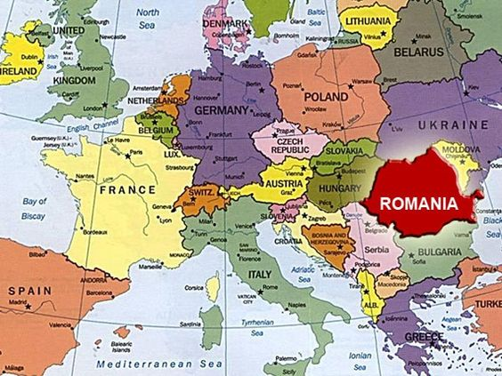
Romania is situated in the eastern part of Central Europe.
Bucharest is the capital city of Romania.

Slide 5
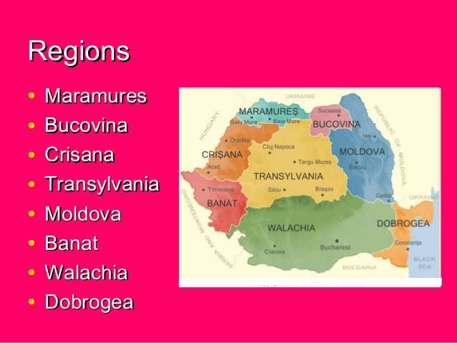

Slide 6
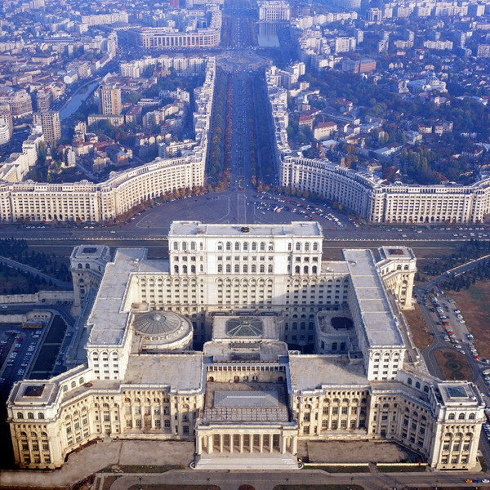
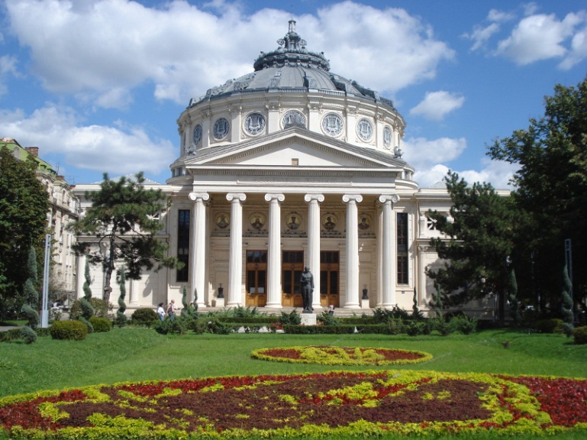
bucharest
Bucharest is Romania's capital and at the same time, the largest industrial and commercial center of the country. A population of 1,944,367 inhabitants makes Bucharest the 6th city in population in the European Union. The first mention of locality appears in 1459. In 1859 became the capital of Romania. Since then, undergoes constant change, being the art scene, culture and media. Between the two world wars, Bucharest elite elegant architecture and brought the nickname "Little Paris." Currently, the capital has the same administrative level as a county and is divided into six sectors.

Slide 7
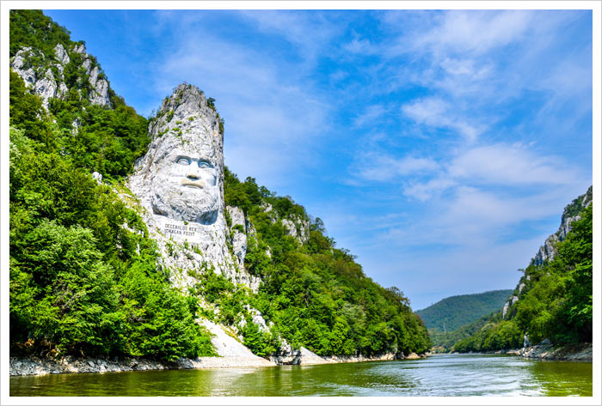
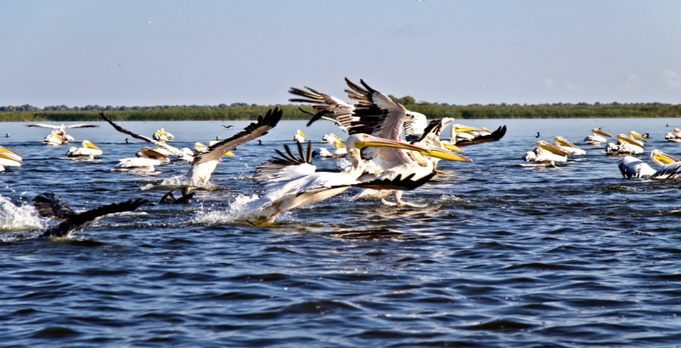
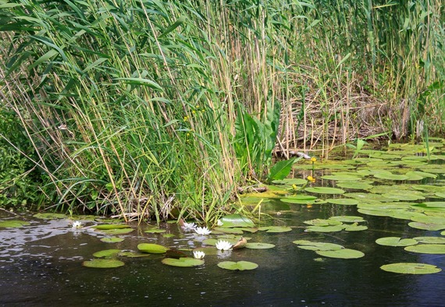
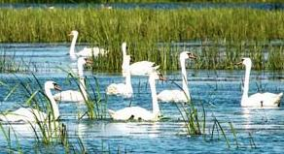
THE DANUBE delta
Romanian part of the Danube is 1075 km long, which is the longest segment of the river within single country. Its landscapes change - from the steepest cliffs, to broad and peaceful plains, until it reaches the Black Sea. Just before the end of its journey, the Danube divides into an expansive delta - The Danube Delta, second largest and best preserved delta in Europe.

Slide 8
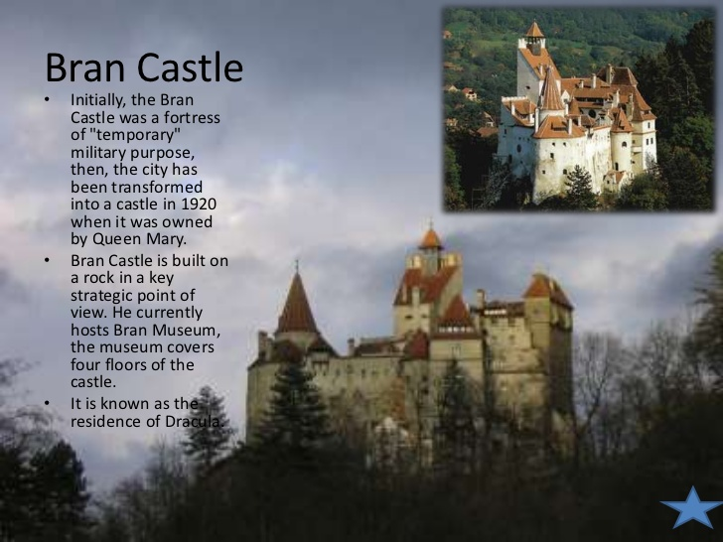

Slide 9
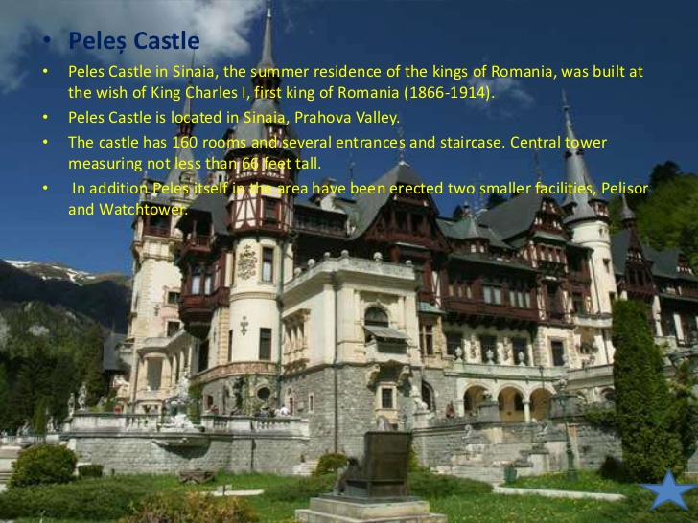

Slide 10
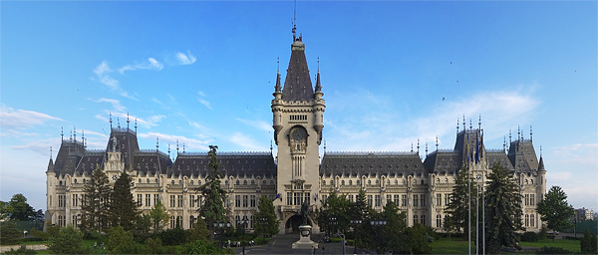
The palace of culture, iasi, moldavia
The Palace of Culture (Romanian: Palatul Culturii) is one of the largest buildings of Romania, located in the city of Iaşi, Northeastern Romania. The Palace of Culture in Iaşi is the main attraction point of the Moldavian capital. The famous building shelters four museums, The Moldavian Museum of History, The Moldavian Museum of Ethnography, The Museum of Art, Museum of Science and Technology.

Slide 11
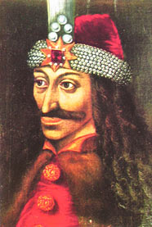
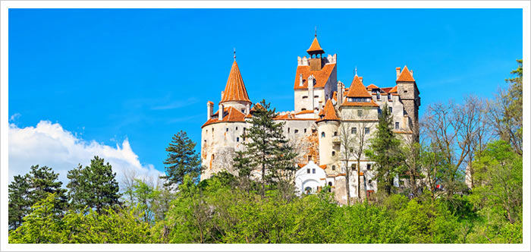
Vlad Dracula was born in the town of Sighisoara . He was the second son of Vlad II Dracul, Prince of Wallachia, in present-day Romania. The nickname "Dracul" means either "devil" or "dragon". Bram Stoker found inspiration for his book about Count Dracula in the life of Vlad III the Impaler of Walachia.

Slide 12
The Palace of Parliament
Starting from an old idea, the building of the Palace of Parliament was built under Nicolae Ceauşescu during a period with high economic hardship. The dictator’s tendency was, on the one hand, to focus all the main bodies of the state in one building and, on the other hand, Ceauşescu wanted a safe place to live under a seismic risk, that would hold up to even a nuclear attack.
The building has a surface of 365.000 sqm and holds the 1st position in the Guinness World Records for the largest administrative building (for civil use), and the 3rd place worldwide from the volume point of view of; it is the heaviest and most expensive building in the world.
20 churches were destroyed, 8 were moved, 10,000 homes were demolished, and over 57,000 families were evicted , in order for this impressive construction to be built. Today, the building is the seat of the Parliament of Romania.

Slide 13
