Slide 1
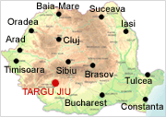
TÎRGU-JIU
Fast Facts:
Location: South West of Romania
County: Gorj
Size: 7.2 sq. miles (19 sq. km)
Population: 78,000
First documented: 1406
Distance from the capital:263 km

Slide 2
City highlights:
A former Roman settlement, the city of Targu Jiu lies at the foothills of the Carpathian Mountains, on the banks of the river Jiu. Inhabited since Paleolithic times, the region of western Oltenia was of strategic importance to the Romans. The area provided direct access, through one of the most spectacular passes in the Carpathians, to present-day Transylvania, the heart of the former Dacian Kingdom.
The Jiu River valley was the scene of heavy fighting during World War I and World War II. Here, in a monumental ensemble, Brancusi created three sculptures as a memorial to the 8,500 Romanian soldiers who died defending the Jiu Valley from the advancing German army. The three sculptures, the Silence Table (Masa Tacerii), the Kiss Gate (Poarta Sarutului) and the Endless Column (Coloana Infinitului), are placed on mile-long (1.5 km) east-west axis that runs through the heart of the city.

Slide 3
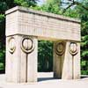
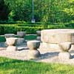
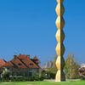
Constantin Brancusi, one of the most influential modern sculptors of the 20th century, was born near Targu Jiu, in Hobita. Although he lived and worked for most of his life in Paris, his legacy is also preserved in Romania, in the city of Targu Jiu.
The Table of Silence, made from limestone, features twelve chairs, originally placed much closer to the table and arranged in pairs.
The Kiss Gate, made out of marble, features a kiss motif on the gate pillars. The entire structure is supported on a steel axle, set in a concrete foundation of five square meters.
The Endless Column stacks 17 rhomboidal cast iron modules in a 30-meter high column. The modules, completed in 1938, were made in the central workshop of Petroşani. The column was restored in 1964.

