Slide 1
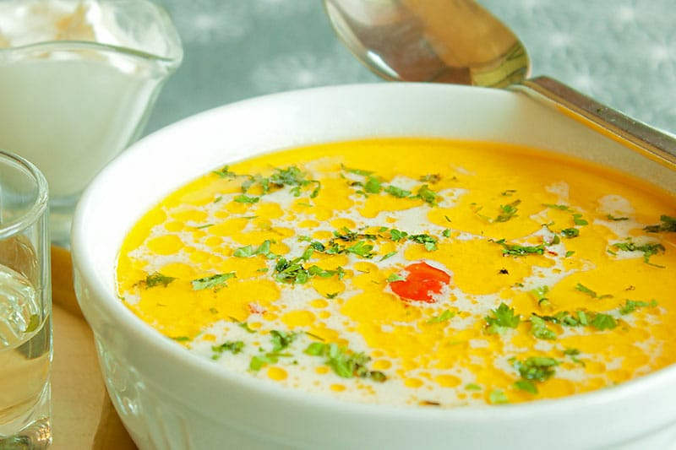
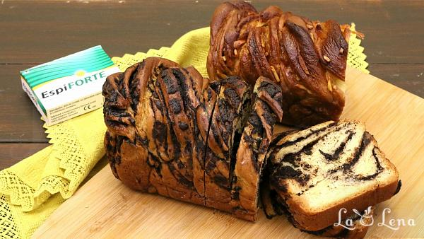
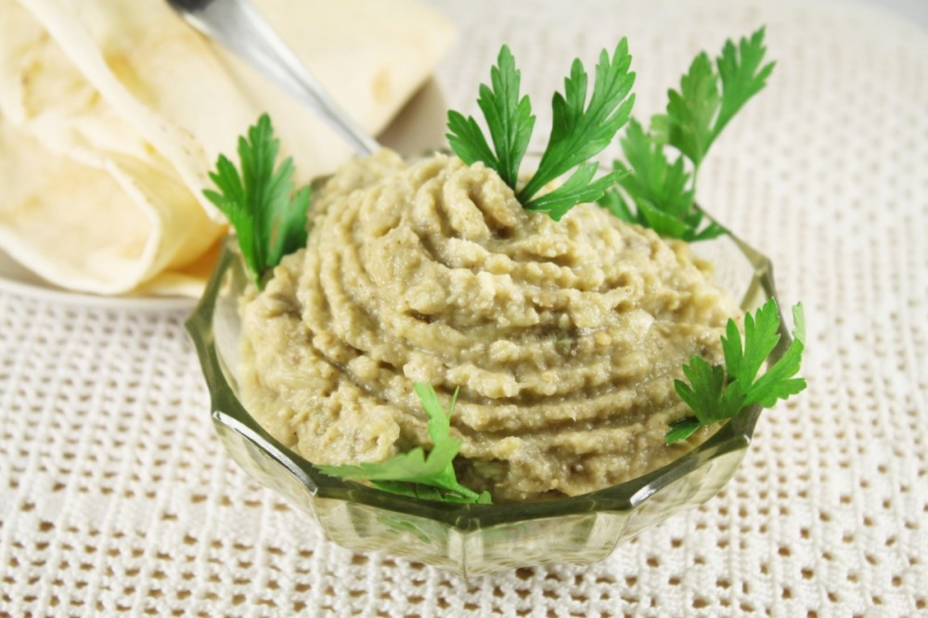
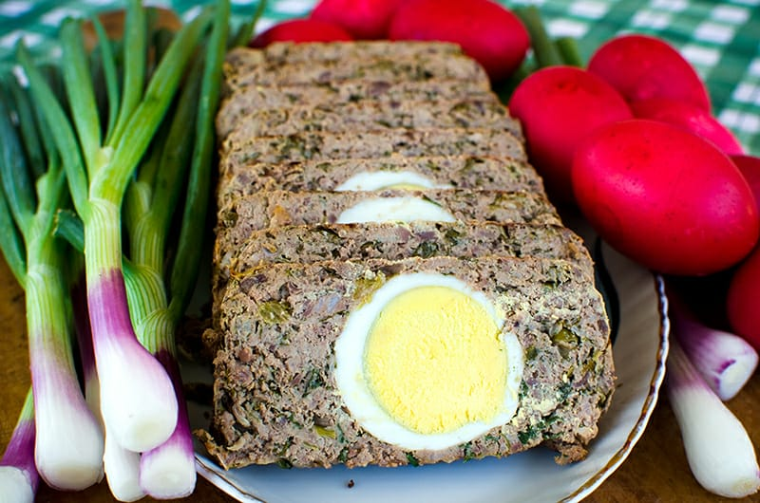
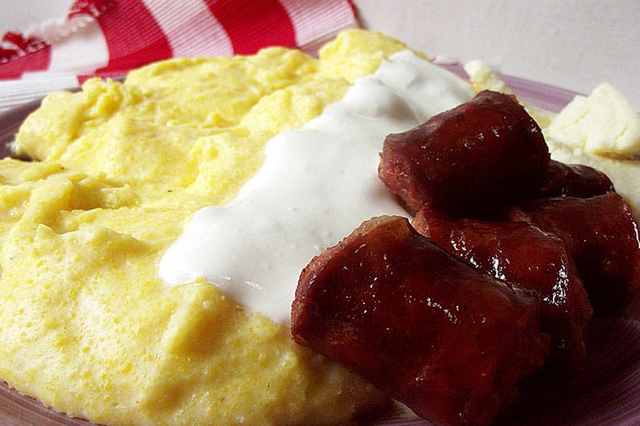
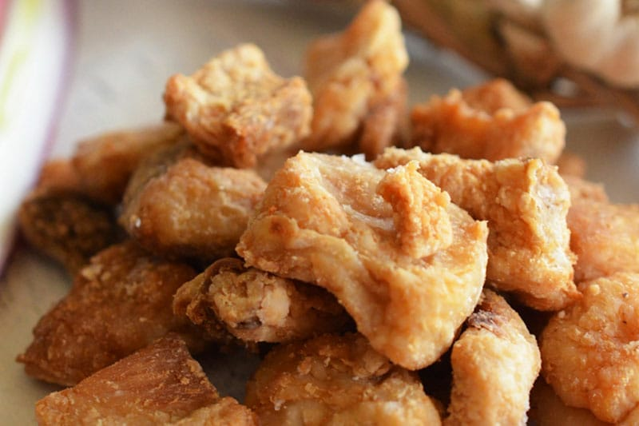
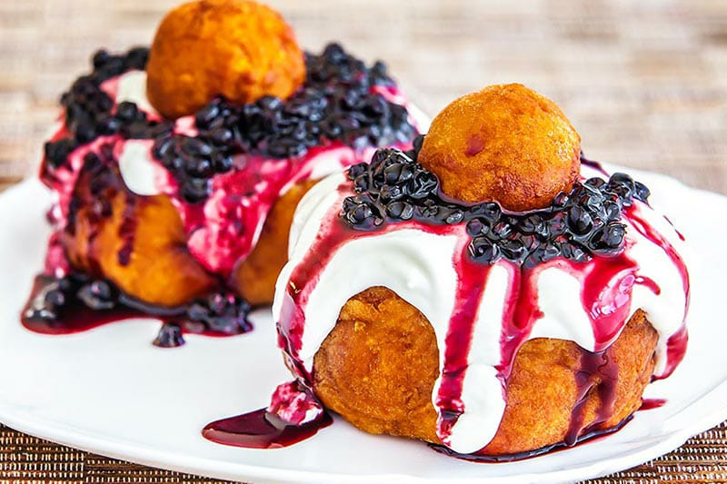
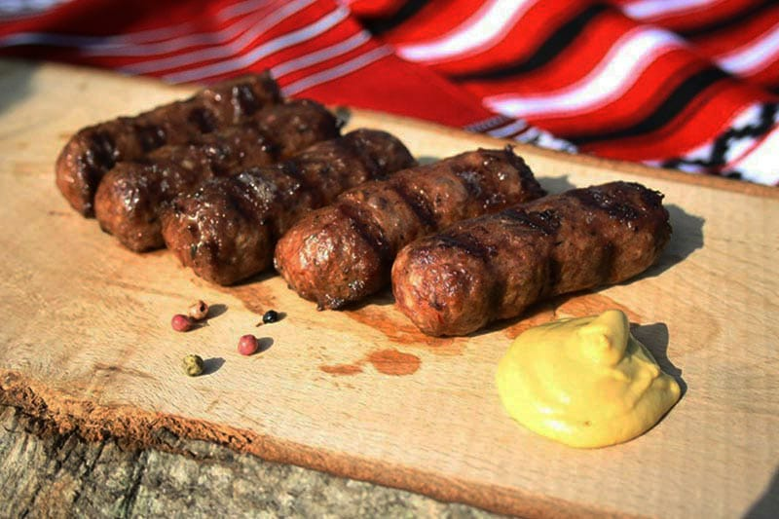
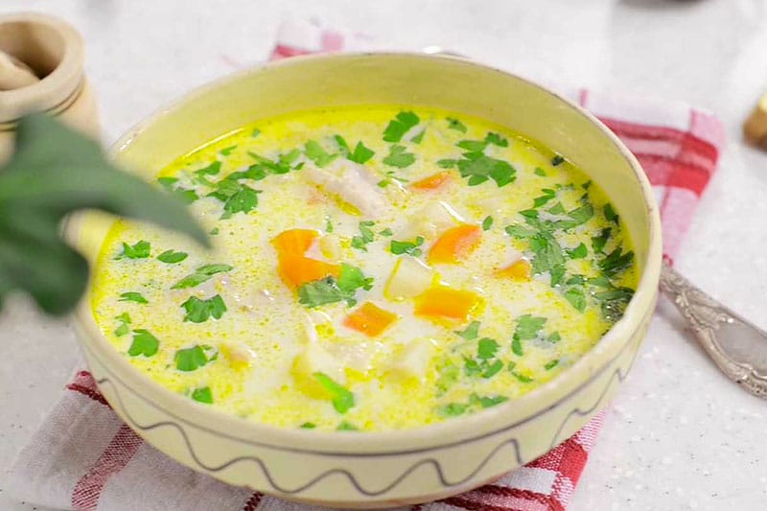
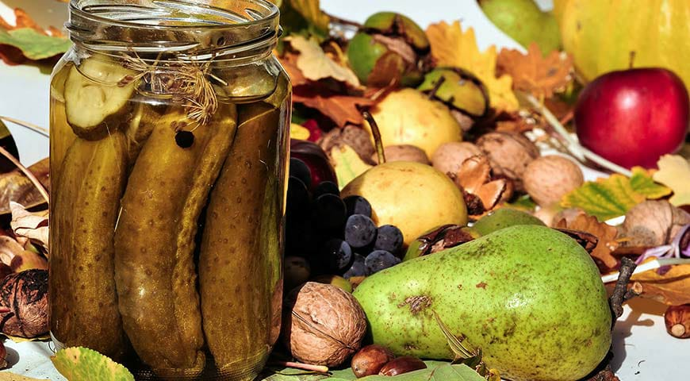
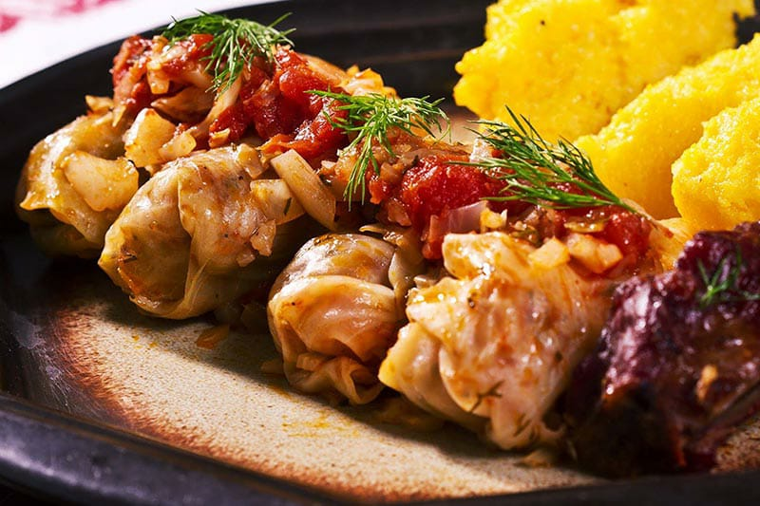
ROMANIAN TRADITIONAL
FOOD

Slide 2
Coming to Romania is a must for any travel enthusiast and food lover because there is such a richness in terms of traditional cuisine, that your senses will be absolutely spoiled with amazing and intense flavors. Romanian cuisine may not be as fancy as French cuisine, and it isn't too spicy or too complicated either. But it is interesting and inviting, and it is the perfect comfort food!
Pork is the most beloved "vegetable" but Romania also excels at soups and salads.
The most peculiar thing about Romanian food is that it has a very familiar taste, but at the same time it tastes like something you've never tried before. This is because the traditional cuisine is actually a mix of dishes and cooking techniques borrowed from neighboring cultures, such as Hungarian, German, Turkish and Slavic, but transformed and Romanised with local herbs and spices.

Slide 3
Sarmale (Cabbage Rolls)
Considered to be Romania's national dish, these stuffed cabbage rolls are actually of Turkish origins, but the Romanians claim that theirs are the best.
The initial recipe was strongly modified over time until it reached what is considered to be now the perfect stuffing. A balanced mixture of rice and minced meat (usually pork or pork combined with beef) and other vegetables and local herbs is rolled in cabbage leaves or young grape leaves for a delicate flavor.
The tastiest cabbage rolls are those slowly cooked in clay pots in the oven, covered with a little water, some cabbage brine for sourness, and some slices of traditional bacon for a tasty smoky touch. Traditionally served with mamaliga (often translated as polenta, this is a corn flour mush replacing bread in many traditional dishes) and sour cream, the Romanian cabbage rolls are not only delicious, but very creamy, consistent, and extremely satisfying.

Slide 4
Ciorba de burta (tripe soup)
When it comes to tripe soup, you either love it or hate it. This traditional food has a very strong aroma and a velvety texture which is the result of several hours of work. Besides the beef tripe, this dish also uses beef and pork legs which, are boiled for several hours in order to obtain the delicious soup.
The tripe is not the most important part of the dish, but the soup itself. Besides the bones, several vegetables are used to obtain its delicious taste, such as carrots, bell peppers, hot peppers, celery, and parsley.
Close to the end, a couple of garlic cloves are added in order to enrich the flavor, and everything is served with sour cream, hot peppers, and toast.

Slide 5
Ciorba Radauteana (Radauti Soup)
Ciorbă refers to a type of traditional soup which can be served in many different ways, depending on the ingredients used. But the one called rădăuțeană is among the most appreciated in Romania.
"Invented" in the late '70s in the city of Radauti, this dish is actually an alternative to the above-mentioned soup - the tripe soup, which was considered to be too heavy and many people didn't enjoy the particular flavor of the tripe. So instead of tripe, ciorba rădăuțeană uses chicken breast.
To keep it simple, this dish has plenty of sour cream and garlic in it, and for the specific sour taste, vinegar is used. It's a delicious soup, not too fatty and not too heavy either, but a whole meal in itself.
Best served with homemade bread.

Slide 6
Balmos
100% Romanian, balmoș is a traditional shepherd dish, a genuine tribute to the famous mamaliga, which will blow your mind when tasting it. It's fatty, it's buttery and sticky, it's soft and silky like a cream but heavy and rich in taste, and it has tons of cheese in it.
And it's incredibly easy to make if you have the right ingredients!
Sour cream is boiled with butter and a bit of salt for a couple of minutes. Then, the corn flour is added until it is properly boiled with no lumps in it, and finally, plenty of salty traditional fermented cheese is added.
Served extra hot, with some butter and sweet cheese on top, balmoș is the perfect dish for cold winter nights when all you want is something truly tasty and comforting.

Slide 7
Jumari (Smoked bacon and greaves)
This is a traditional Romanian appetizer made, of course, from pork.
In Romania, the traditional bacon is called slănină, and it is actually smoked salty pig fat flavored with garlic, pepper, paprika, and several other spices, and it's a dish usually prepared by all Romanian families for the winter time.
The frying crunchy version is called jumari, meaning greaves, and along with slănină, accompanied with raw onions, homemade bread, and a shot of țuică (traditional plum brandy) as digestive, they make up for the perfect starter of an authentic Romanian meal.
Definitely, a must try!

Slide 8
Mici
This is the most popular Romanian grill dish, and they are so loved that there is absolutely no Romanian who can imagine a proper barbecue without them. These caseless sausages are made of different combinations of ground meat, black pepper, and other spices, and they are grilled until they darken a little and become moist and soft.
They are served simply with mustard and bread. You can find mici in restaurants, in fast foods, in street food shops or you just can buy the mixture from any grocery store, fresh or frozen, ready to be grilled or fried whenever you feel like it.
And for extra satisfaction, wash them down with a cold pint of Romanian beer.

Slide 9
8. Salata de vinete (Roasted Eggplant Salad)
One of the most cooked and eaten Romanian appetizers, the eggplant salad is the perfect choice for a quick snack and an amazing starter for a traditional Christmas dinner. It is easy and cheap to make, and you can top it with tomatoes.
The traditional way to prepare this appetizer is to roast the eggplants on a grill until they become really soft, but you can also roast them on the stove top or bake them in the oven. Afterward, all you have to do is remove the skin, chop them, and dress them either with sunflower oil and chopped onions or mayonnaise and garlic.

Slide 10
Drob de miel (Lamb Drob)
In the Romanian tradition, the Lamb Drob is a dish which is exclusively prepared during Easter.
The Lamb Drob is a delicious appetizer made with lamb offals (liver, lungs, spleen, heart, and kidneys), eggs, green onions and several herbs such as dill, garlic, and parsley.
The Lamb Drob has a medium preparation difficulty, but to be honest, it's not rocket science. The most important part is washing and preparing the lamb offals. Afterward, you just have to chop them, mix them with the rest of the ingredients, and bake them.
The Drob is best served cold with mustard and boiled eggs.

Slide 11
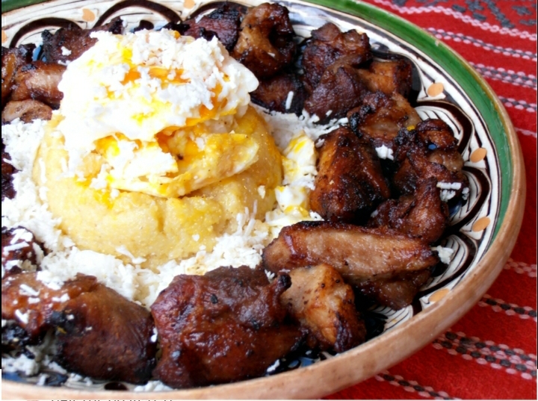
Tochitura moldoveneasca (Moldavian Stew)
There is nothing like the famous Moldavian stew, and there is no exaggeration in saying that this is the ultimate Romanian dish, as it combines the best traditional foods Romania has to offer: mamaliga (polenta), traditional salty fermented cheese, fried eggs, fried pork, traditional sausages, and pickles. It's the perfect combination of tastes and textures.
It's Romania on a plate!
The stars of this traditional dish are the pork and sausages, which are best cooked over an open fire in a cast-iron stew pot, but they can also be fried in a skillet. Over the delicious meat is then added white wine, tomato paste, onions, garlic, and bay leaves.

Slide 12
Papanasi with sour cream and jam
A traditional dessert originating from the northern part of the country but popular among all Romanians, being available in almost every restaurant.
Papanasi are a kind of fried cheese doughnuts best served hot, with sweet and sour cream, and preferably, blueberry jam. Maybe it doesn't sound too appetizing but the taste and the gummy texture combined with the blueberries' sourness is absolutely divine!

Slide 13
Authentic pickles
Once autumn begins, every Romanian household in the countryside reaps what they grew and prepares for the cold winter.
And while dishes may differ from one region to another, preparing pickles is a tradition in the whole country. The most common pickles are pickled cucumbers, but you can also use peppers, cauliflower, or cabbage.
The recipe for these delicious appetizers is really easy, and they are a perfect addition to the Romanian main course, dominated by pork.

Slide 14
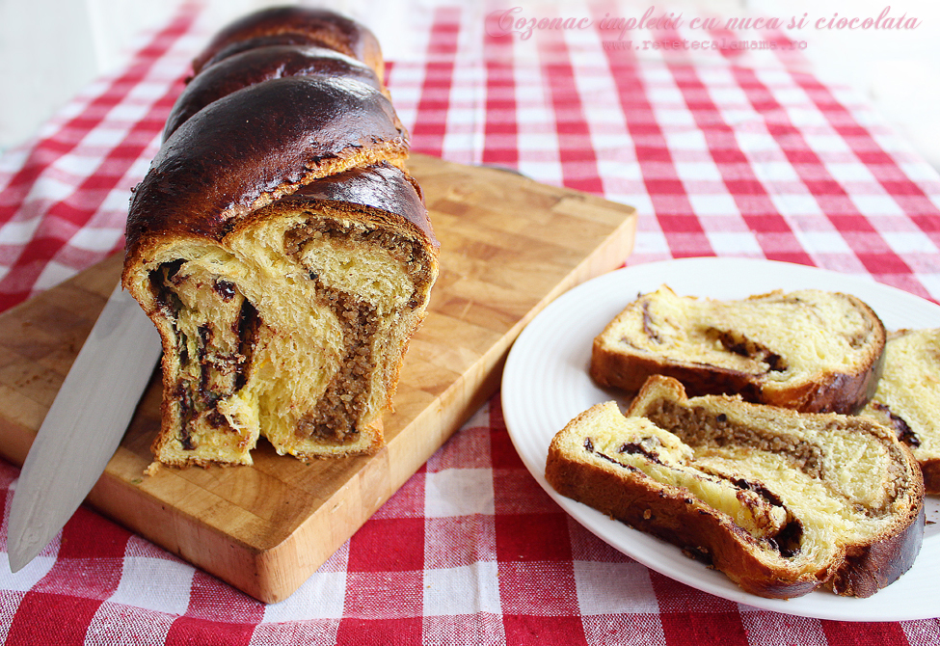
COZONAC – It’s a sweet bread , which the Romanians usually cook and eat around big religious holidays such as Christmas or Easter (but also for big family meals or major personal events such as traditional weddings), and the traditional Easter dessert pasca cake with a sweet cottage cheese filling at the center).

