Slide 1
Country
Romania
District
Gorj
Locality
Bârsești
Technological Highschool Bârseşti
High School

Slide 2
Our school presentation

Slide 3
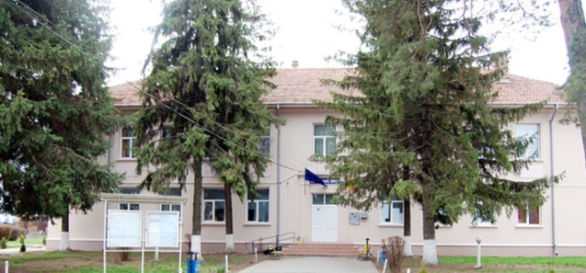
The name of our school is:
Technological High School Bârseşti

Slide 4
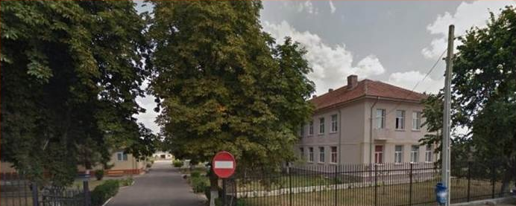
Street view of our school

Slide 5
Historical Background
Technological High school Bârseşti is part of the network of schools associated Tg-Jiu Gorj, from which it is situated 4 km away to the north-west.
Our school was founded on December10th , 1947, when was inaugurated the School of Horticulture Practice of Bârseşti village, Gorj county, necessary for this part of northern Oltenia.
In the founding year, the school functioned with fewer students (45), due to the financial instability, and lack of qualified teachers.
Due to the improvement of schooling number of students, between 1963-1964 in school were 410 students. During this time school acquired the name Agricultural School Bârseşti Center.
Since 1990, the school operates as Bârseşti Agricultural School Group, with grades of high school, vocational school and post-secondary school.
Currently its name is Technological High school Bârseşti.
It has 800 students and the following forms of education: secondary education, part time courses and post-secondary education.
Our school is the only high school from Gorj, which educates both teenagers and adults in Agriculture Field.

Slide 6
At our school we have:
Computer classrooms
Laboratories
Language classrooms
Documentation and Information Center
Library

Slide 7
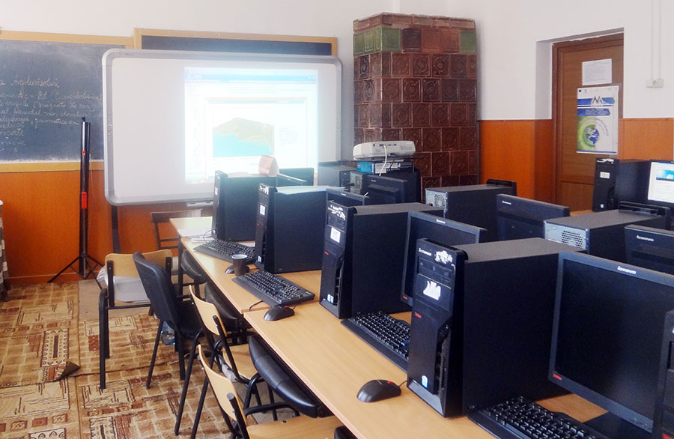
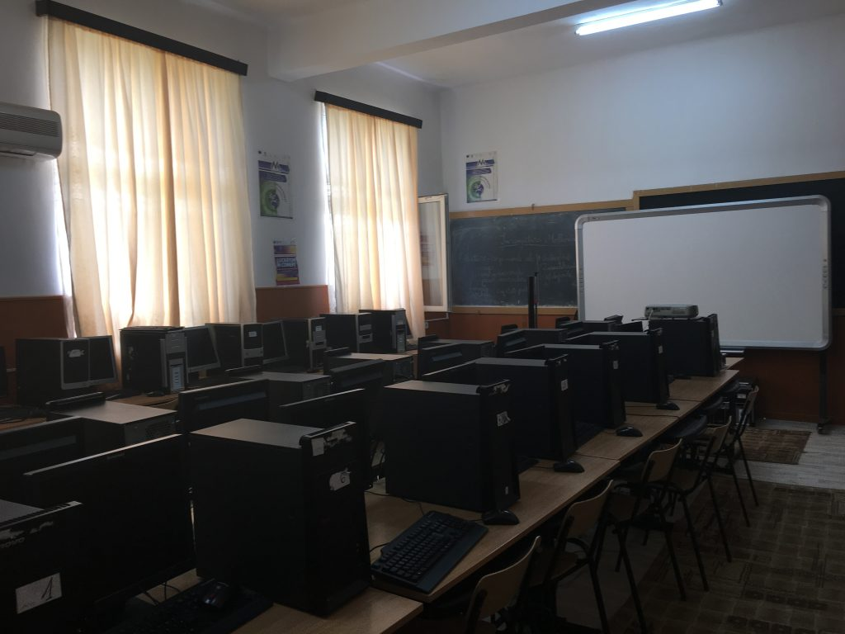
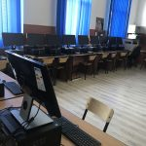
Computer classrooms

Slide 8
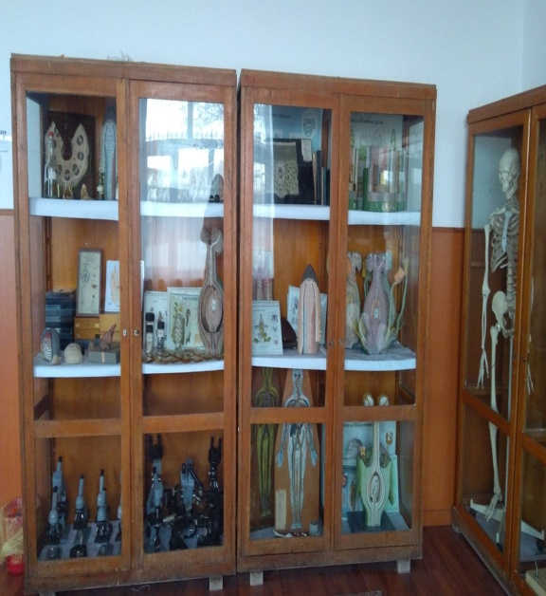
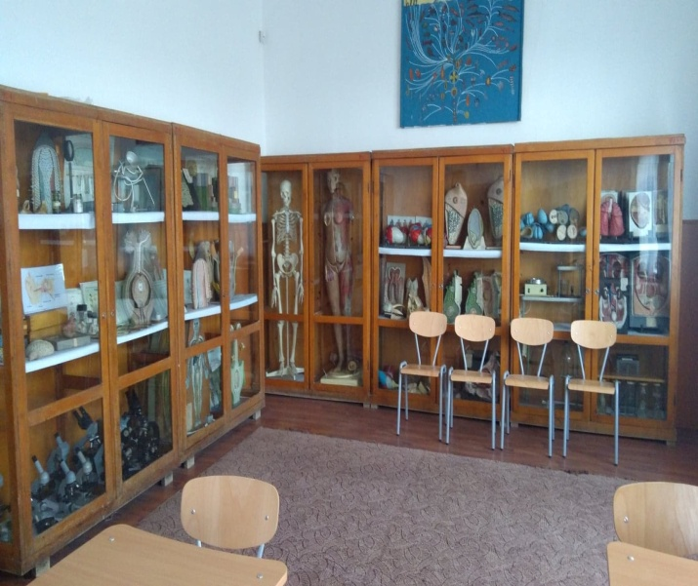
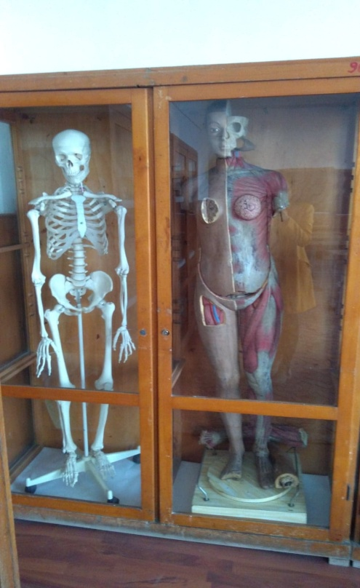
Laboratories - Biology Lab

Slide 9
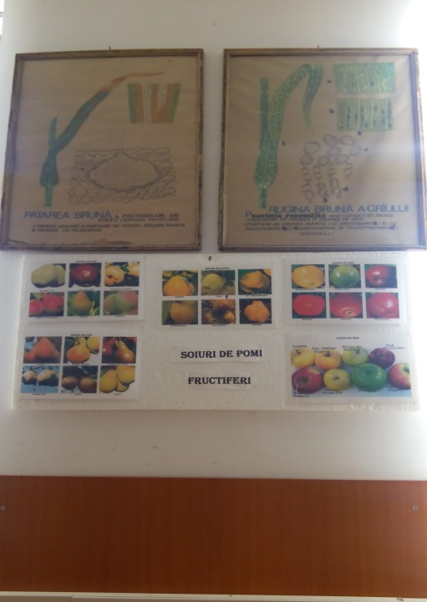
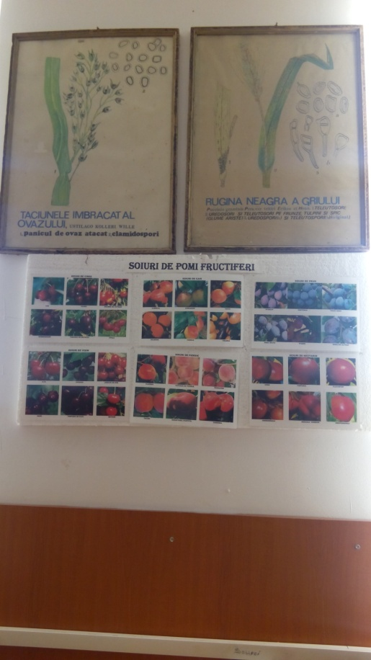
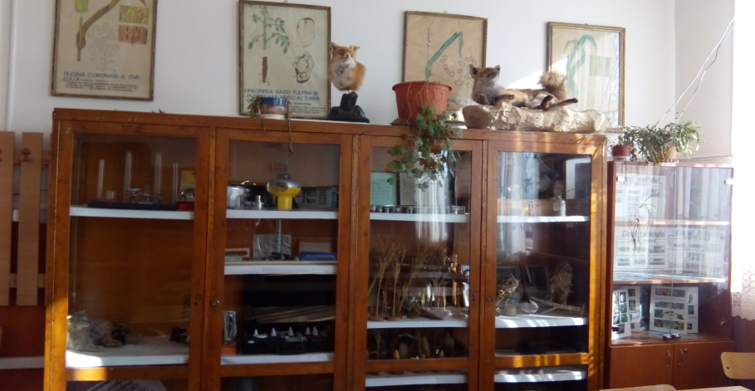
Plant Protection Lab

Slide 10
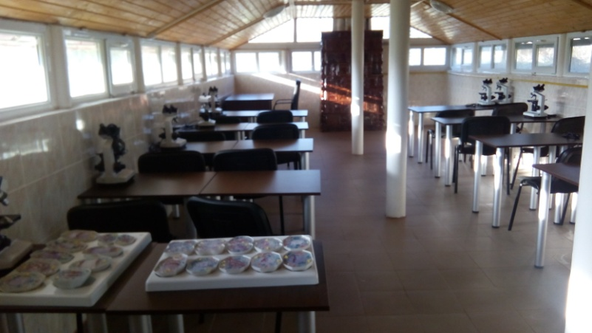
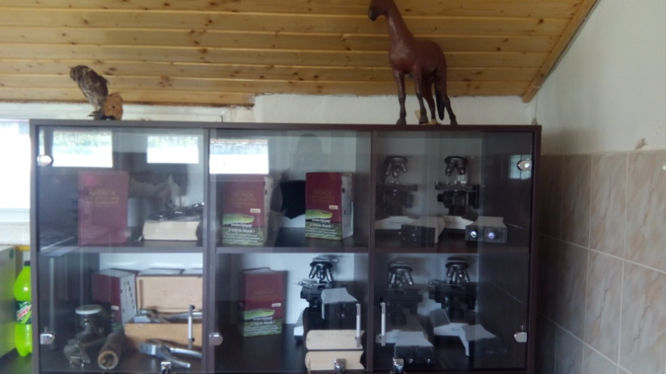
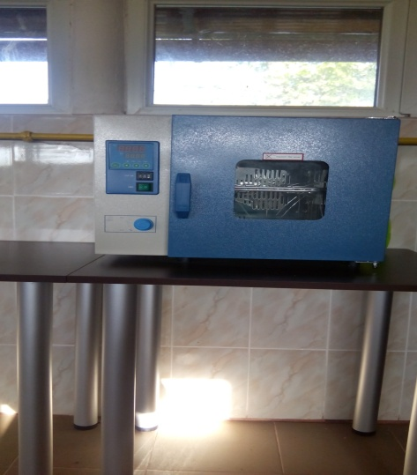
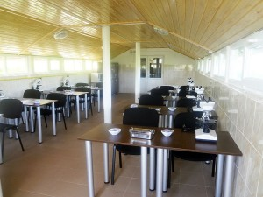
Veterinary Practice Lab

Slide 11
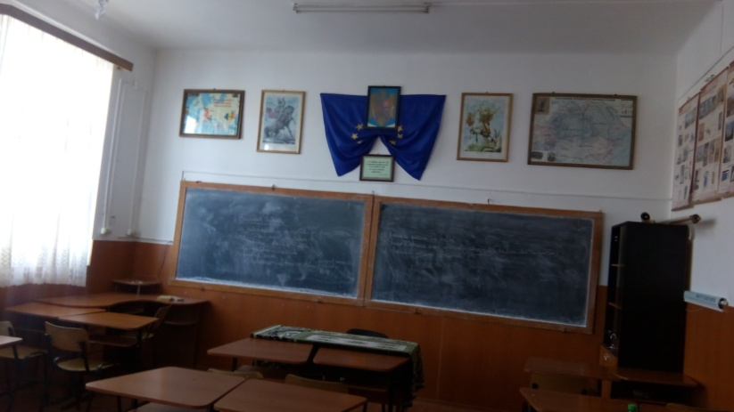
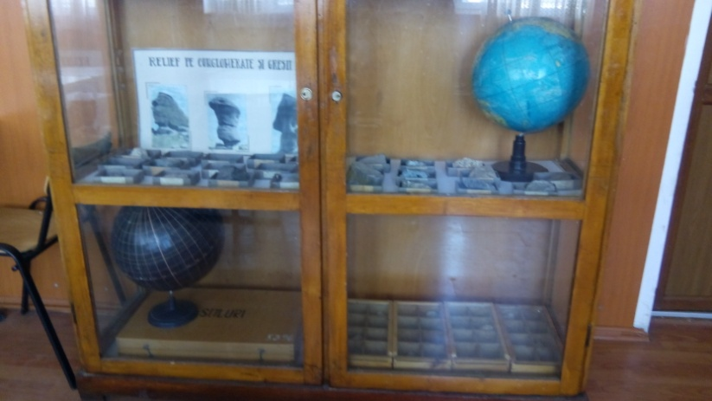
Geography and History Classroom

Slide 12
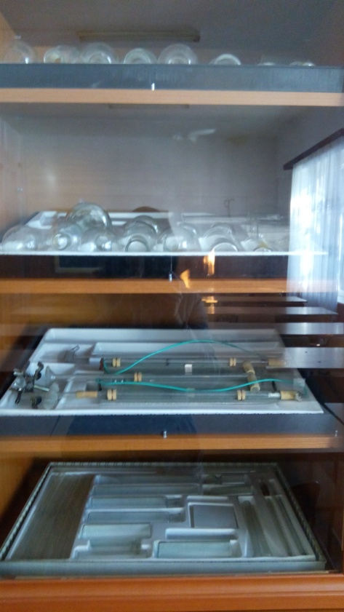
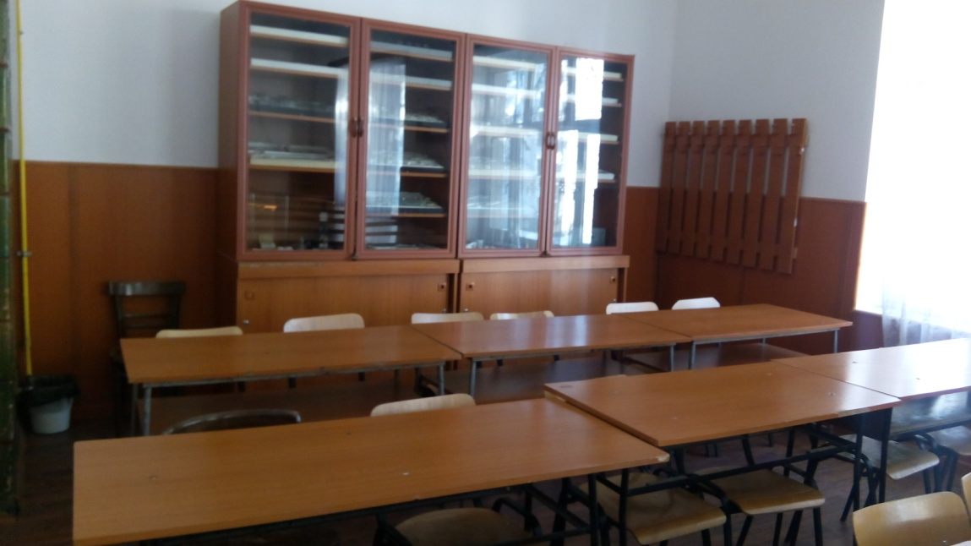
Chemistry Lab

Slide 13
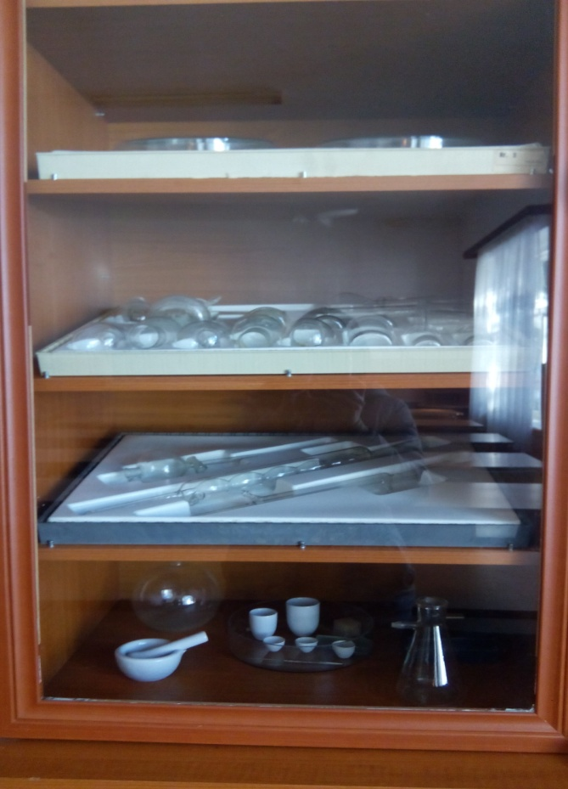
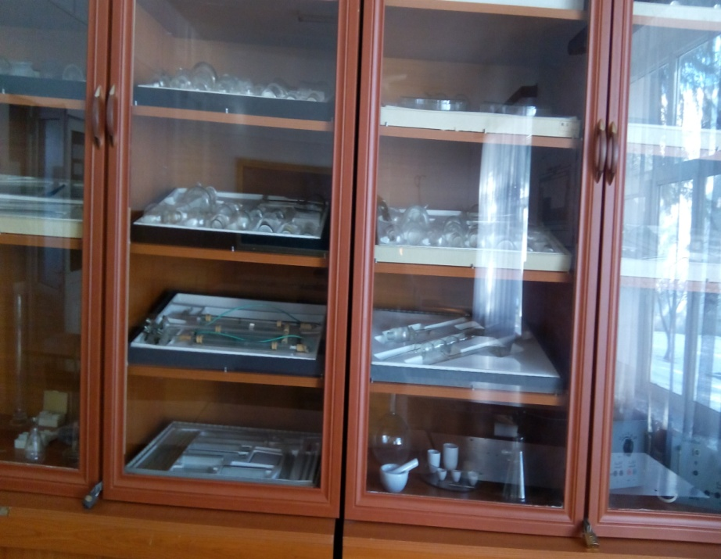

Slide 14
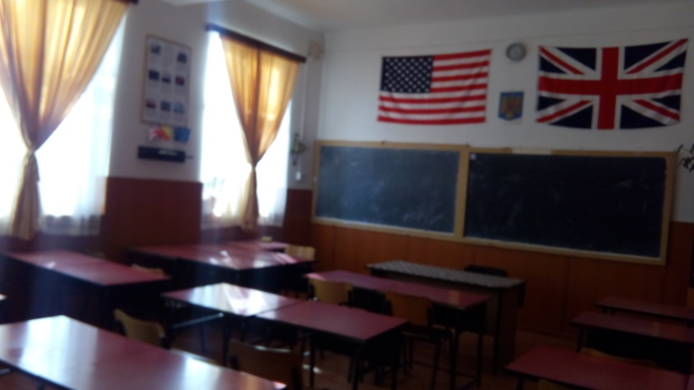
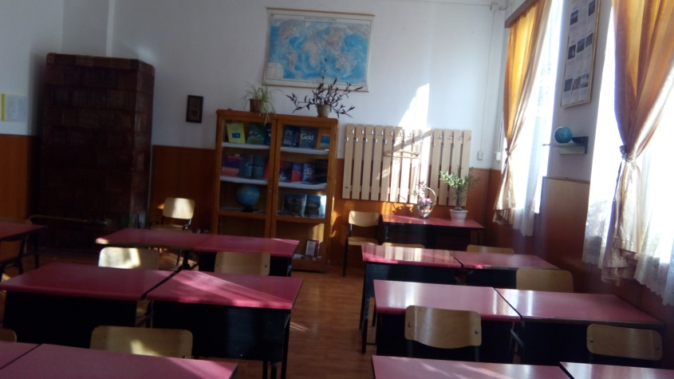
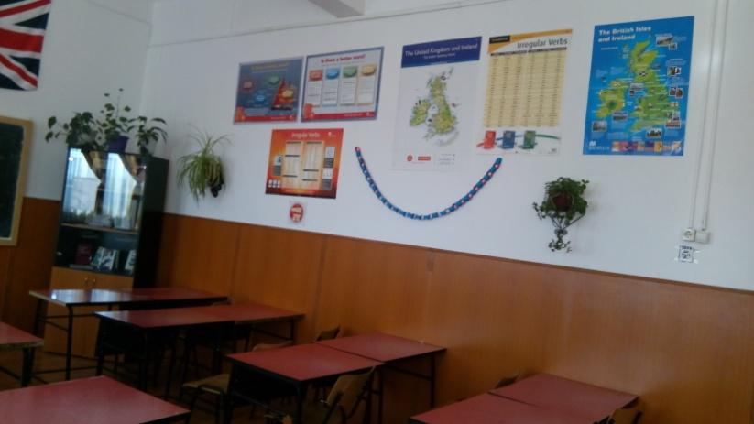
English Language classroom

Slide 15
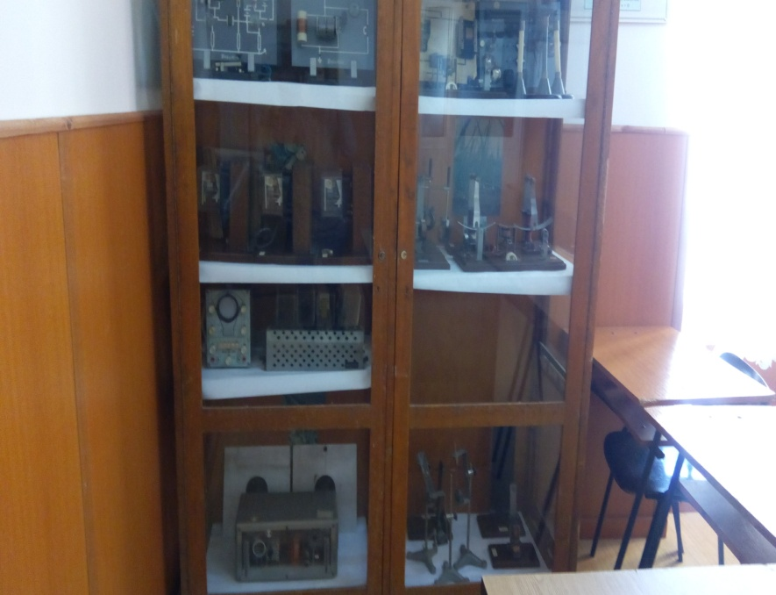
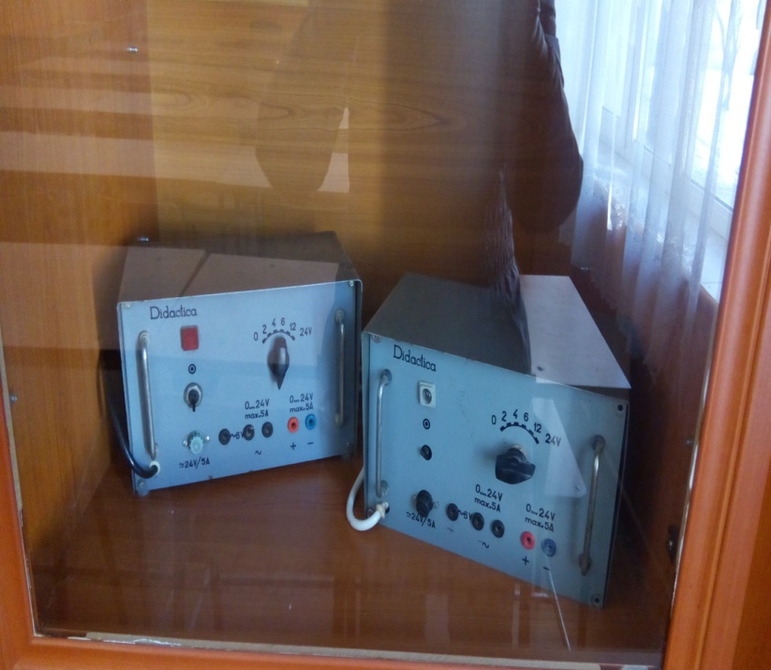
PHYSICS LAB

Slide 16
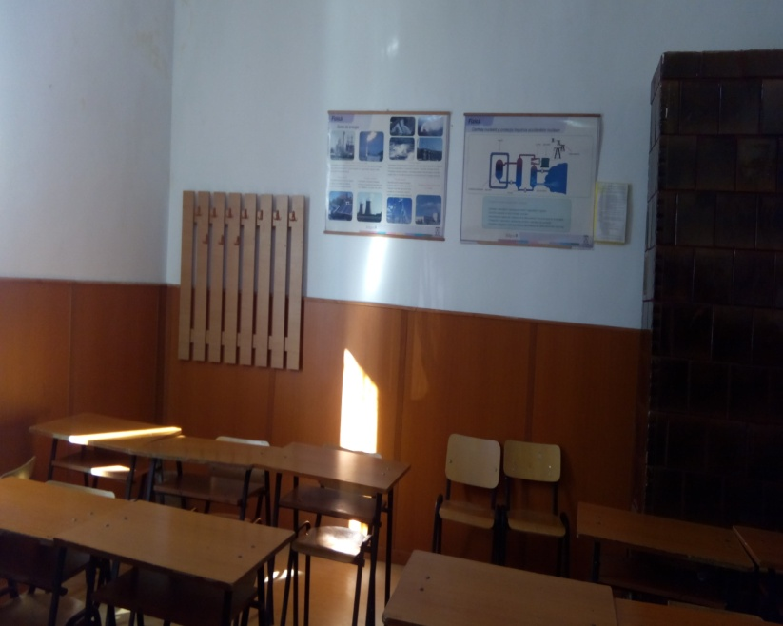
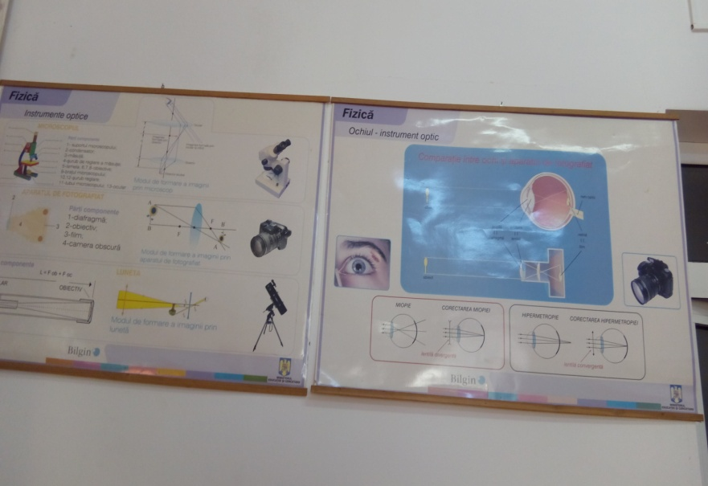

Slide 17
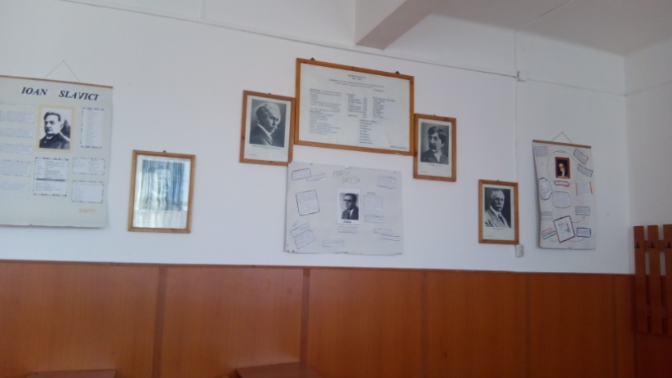
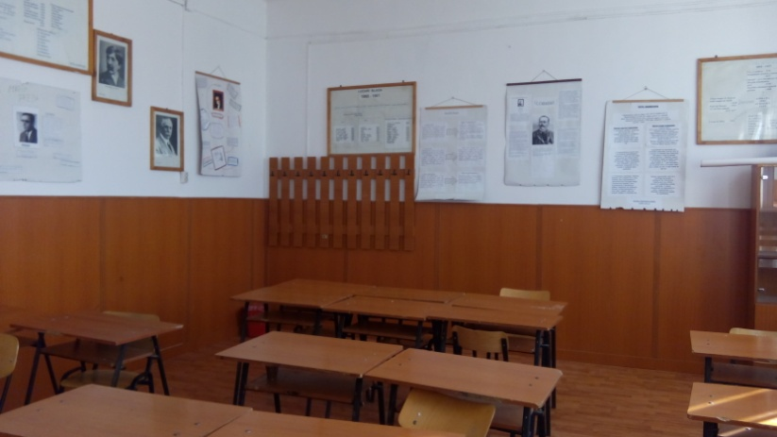
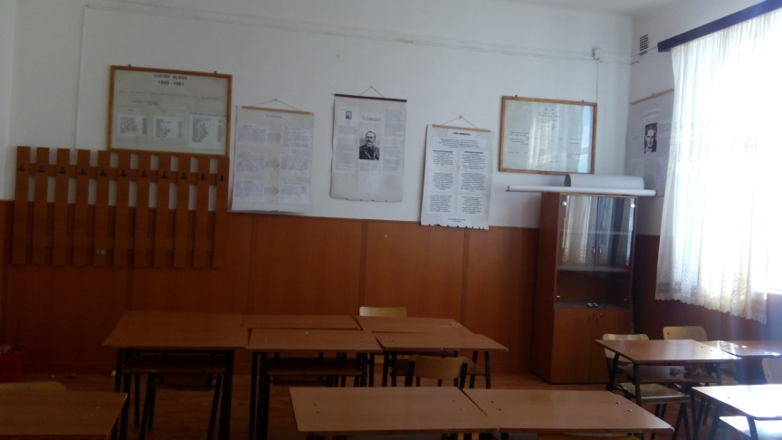
Romanian Language classroom

Slide 18
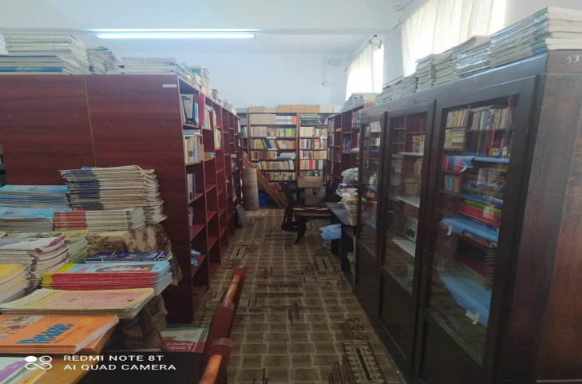
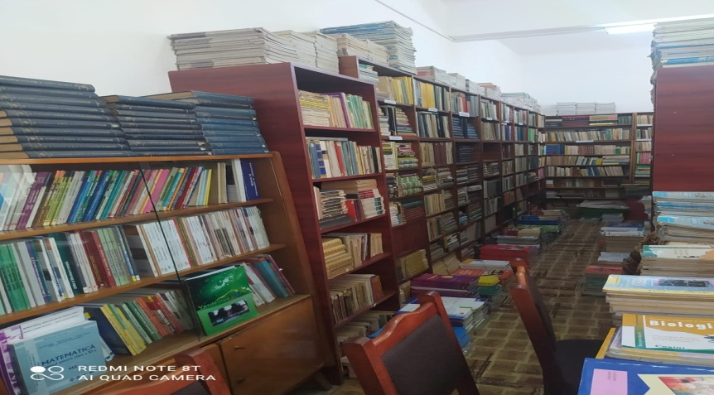
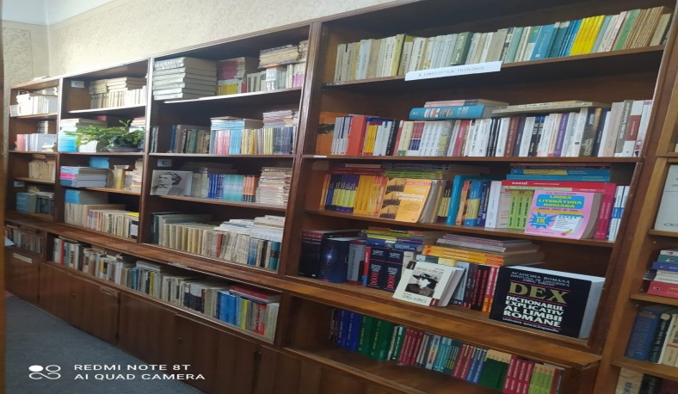
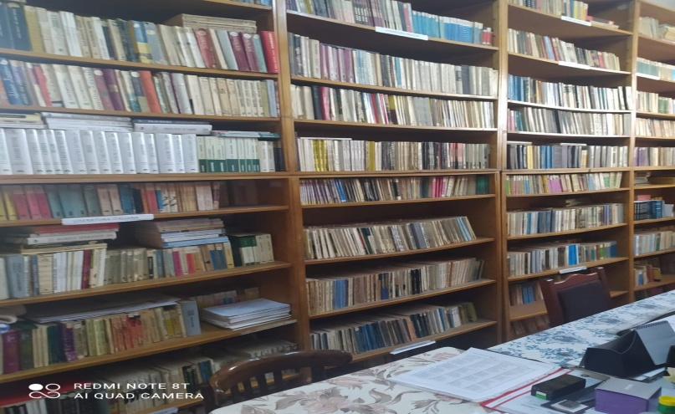
The Library

Slide 19
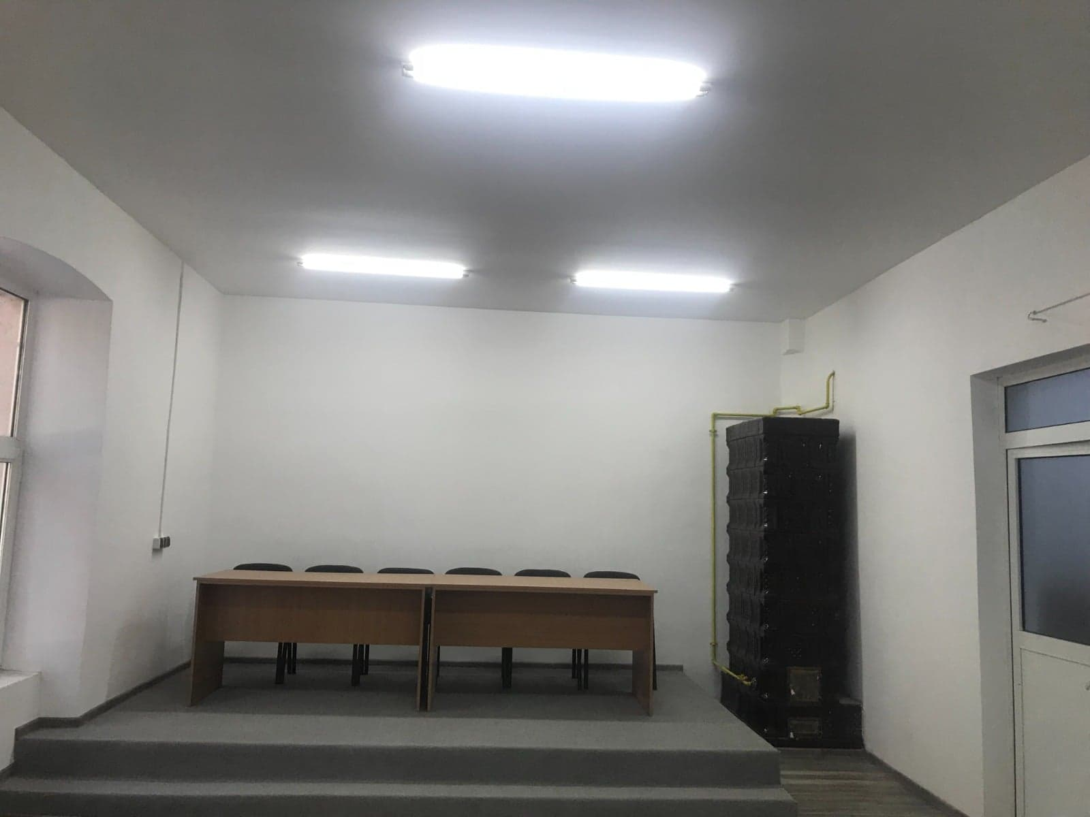
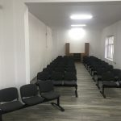
AMPHITHEATRE

Slide 20
Our highschool′s specializations are:
Ecologist Technician and the Protection of Environment’s Quality
unique in South West Oltenia region
Agro-mountain Technician
Plant′s Protection Tehnician
Economic Activities Technician
Veterinary Technician
unique in Gorj and with Government fundings
Sciences of Nature

Slide 21
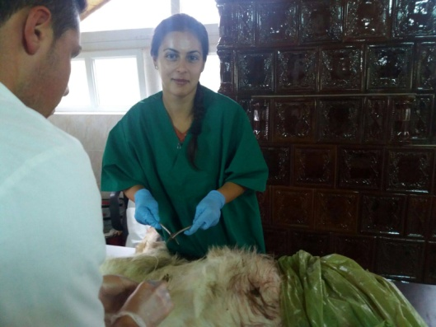
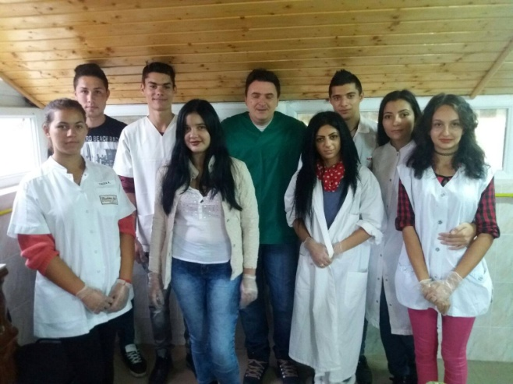
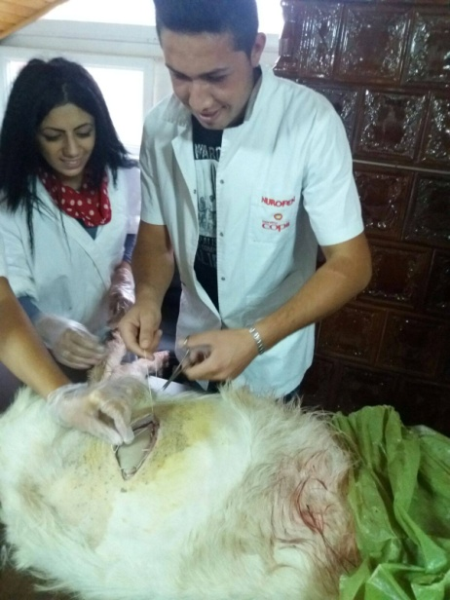
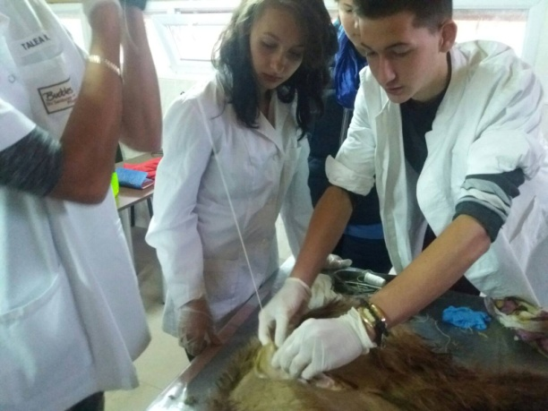
Our curricular activities
Veterinary practice

Slide 22
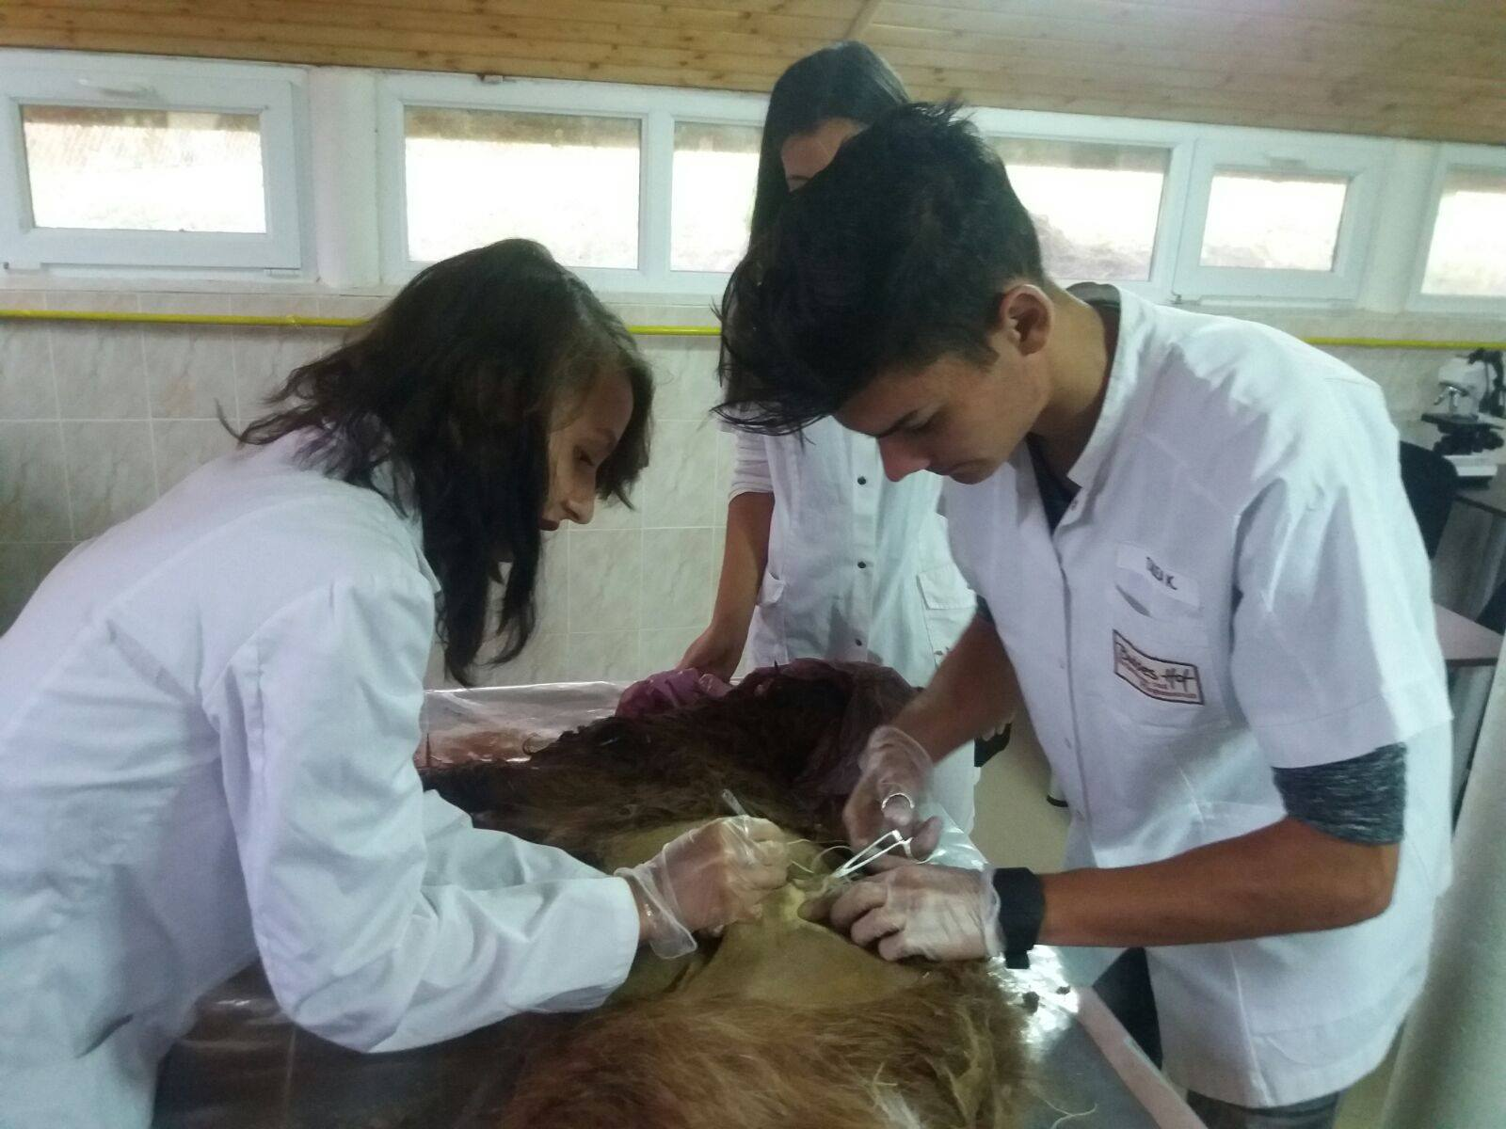
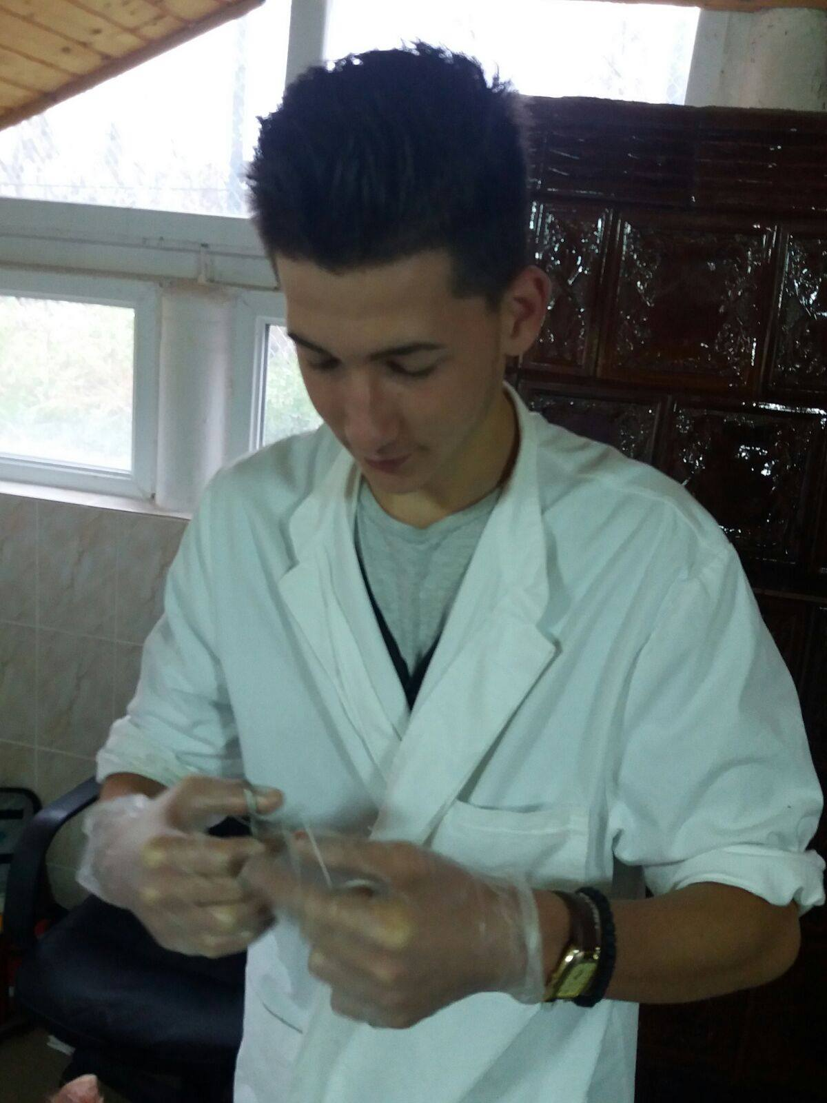
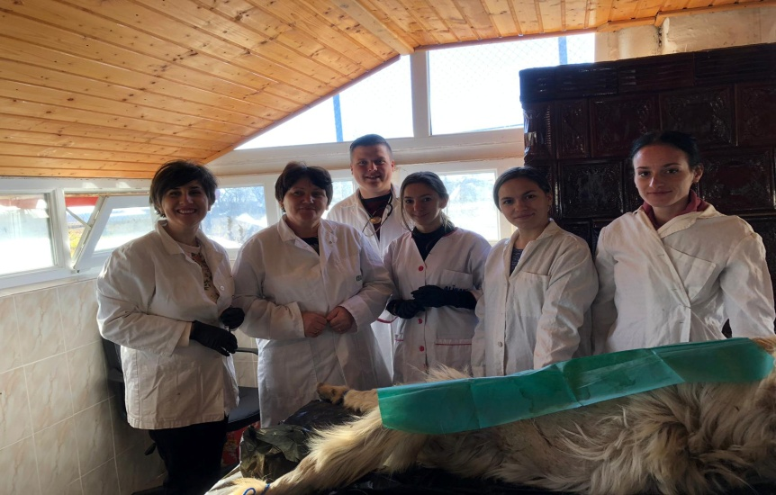

Slide 23
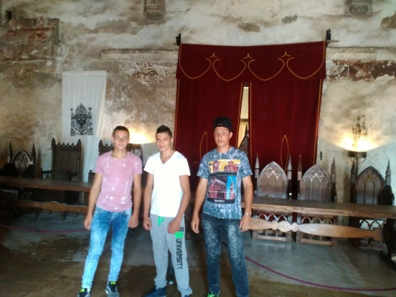
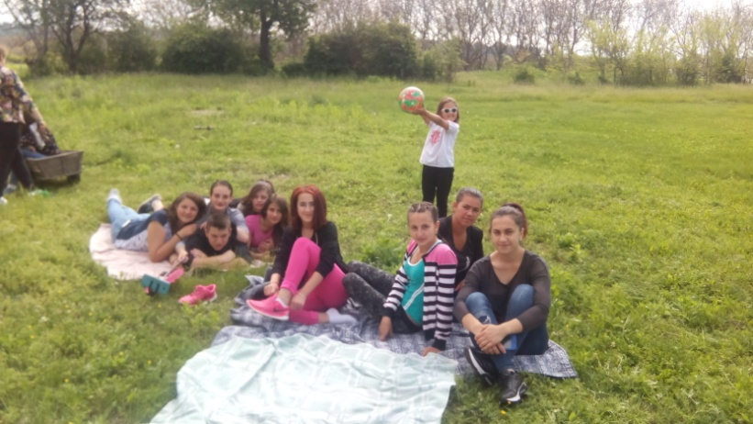
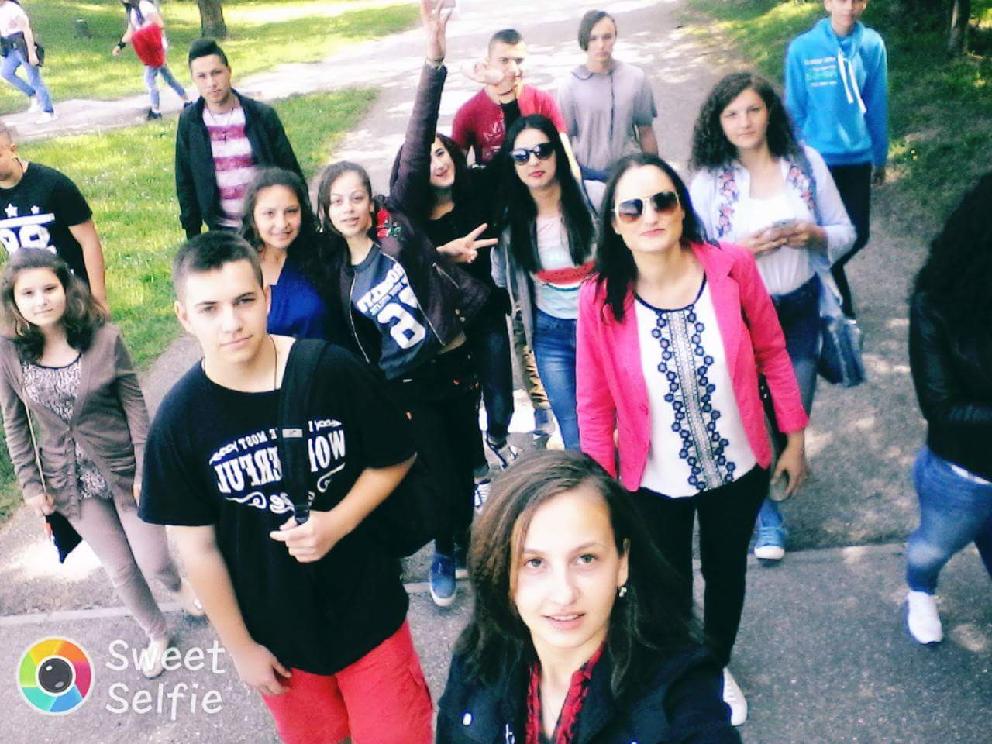
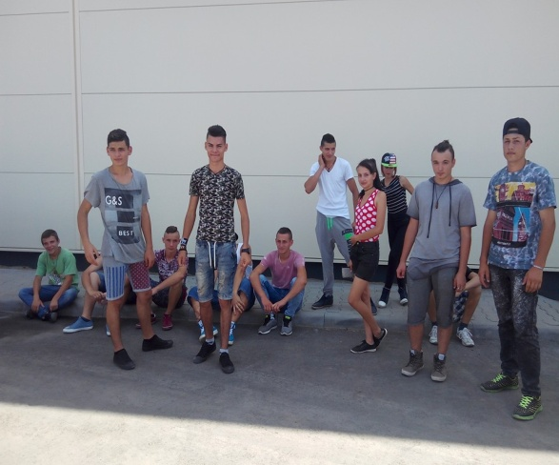
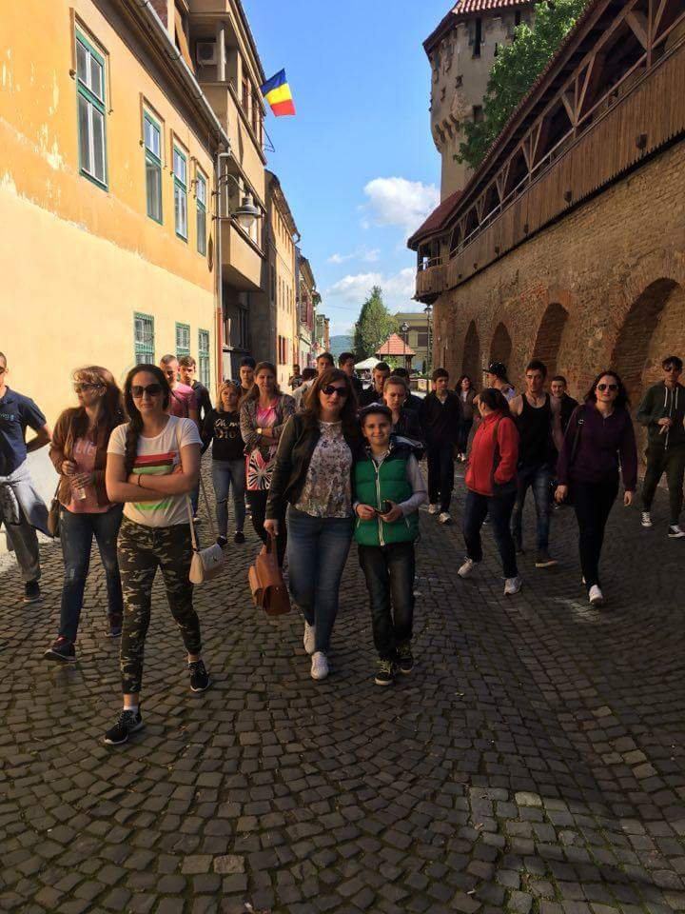
Our extracurricular activities

Slide 24
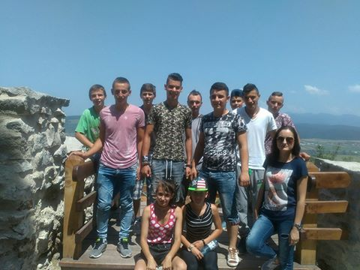





Slide 25





Slide 26



Slide 27



Volunteering activities

Slide 28



We celebrate The International Day Of Tolerance

Slide 29



Let’s do it Romania!- ecological activities

Slide 30



Slide 31



We celebrate Christmas and decorate the Christmas tree

Slide 32







We celebrate Halloween

Slide 33




E-Twinning projects

Slide 34



1stDecember-The National Day

Slide 35
LICEUL TEHNOLOGIC BIRSESTI
Tîrgu Jiu, Gorj, cartier Bîrseşti, nr. 8, tel/fax: 0253/214002, web site: www.barsesti.go.ro

